Slide 1
Unit 1
Database and Database users
Introduction
View of data
Advantages
Actors and architecture

Slide 2
History of Database Systems
1950s and early 1960s:
Data processing using magnetic tapes for storage
Tapes provided only sequential access
Punched cards for input
Late 1960s and 1970s:
Hard disks allowed direct access to data
Network and hierarchical data models in widespread use
Ted Codd defines the relational data model
Would win the ACM Turing Award for this work
IBM Research begins System R prototype
UC Berkeley begins Ingres prototype
High-performance (for the era) transaction processing
Notes:
2

Slide 3
History (cont.)
1980s:
Research relational prototypes evolve into commercial systems
SQL becomes industrial standard
Parallel and distributed database systems
Object-oriented database systems
1990s:
Large decision support and data-mining applications
Large multi-terabyte data warehouses
Emergence of Web commerce
Early 2000s:
XML and XQuery standards
Automated database administration
Later 2000s:
Giant data storage systems
Google BigTable, Yahoo PNuts, Amazon, ..
Notes:
3

Slide 4
Database Management System (DBMS)
DBMS contains information about a particular enterprise
Collection of interrelated data
Set of programs to access the data
An environment that is both convenient and efficient to use
Notes:
4

Slide 5
Database Applications:
Banking: transactions
Airlines: reservations, schedules
Universities: registration, grades
Sales: customers, products, purchases
Online retailers: order tracking, customized recommendations
Manufacturing: production, inventory, orders, supply chain
Human resources: employee records, salaries, tax deductions

Slide 6
University Database Example
Application program examples
Add new students, instructors, and courses
Register students for courses,
Assign grades to students, compute grade point averages (GPA) and generate transcripts
In the early days, database applications were built directly on top of file systems
Notes:
6

Slide 7
Drawbacks of using file systems to store data
Data redundancy and inconsistency
Multiple file formats, duplication of information in different files
Difficulty in accessing data
Need to write a new program to carry out each new task
Data isolation — multiple files and formats
Integrity problems
Integrity constraints (e.g., account balance > 0) become “buried” in program code rather than being stated explicitly
Hard to add new constraints or change existing ones
Notes:
7

Slide 8
Drawbacks of using file systems to store data (Cont.)
Atomicity of updates
Failures may leave database in an inconsistent state with partial updates carried out
Example: Transfer of funds from one account to another should either complete or not happen at all
Concurrent access by multiple users
Concurrent access needed for performance
Uncontrolled concurrent accesses can lead to inconsistencies
Example: Two people reading a balance (say 100) and updating it by withdrawing money (say 50 each) at the same time
Security problems
Hard to provide user access to some, but not all, data
Database systems offer solutions to all the above problems
Notes:
8

Slide 9
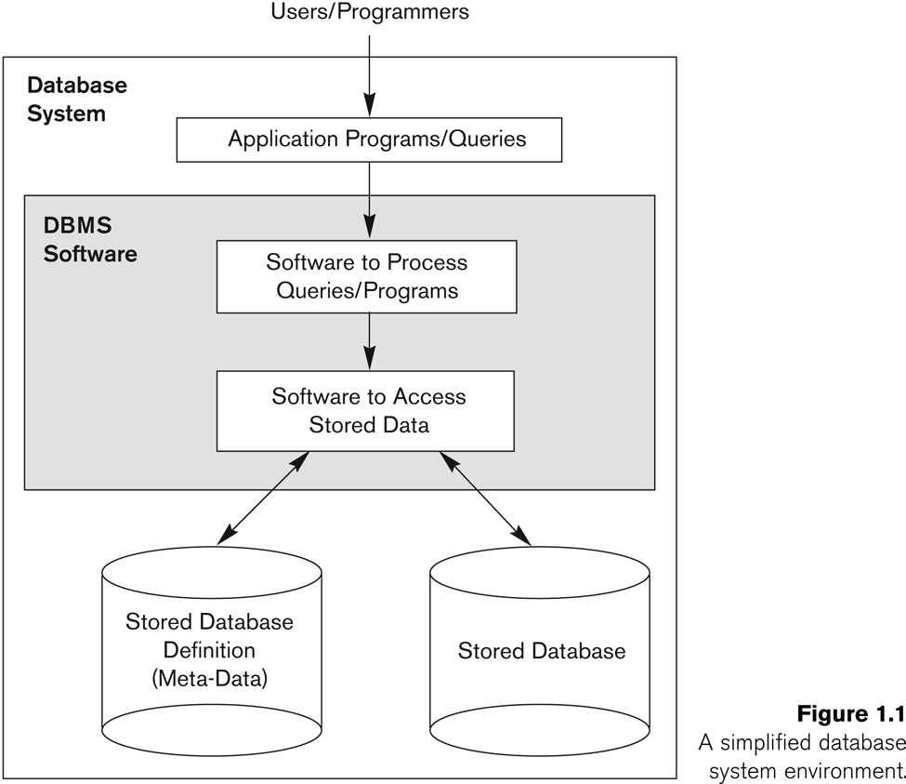
Simplified database system environment

Slide 10
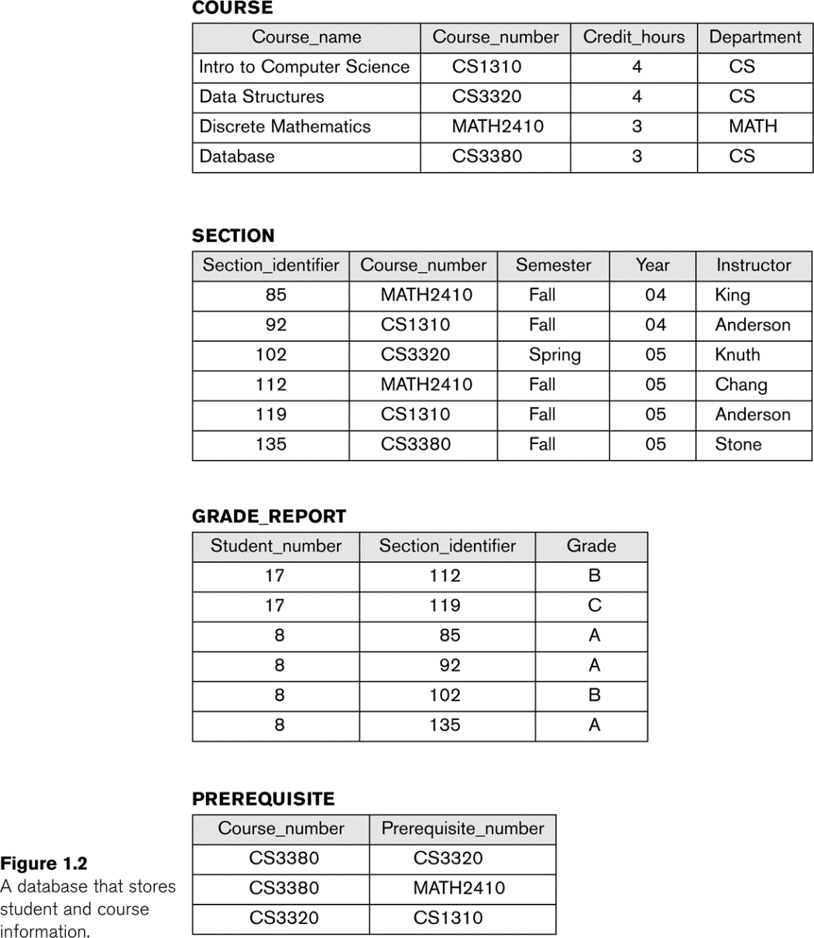
Example of a simple Relational database

Slide 11
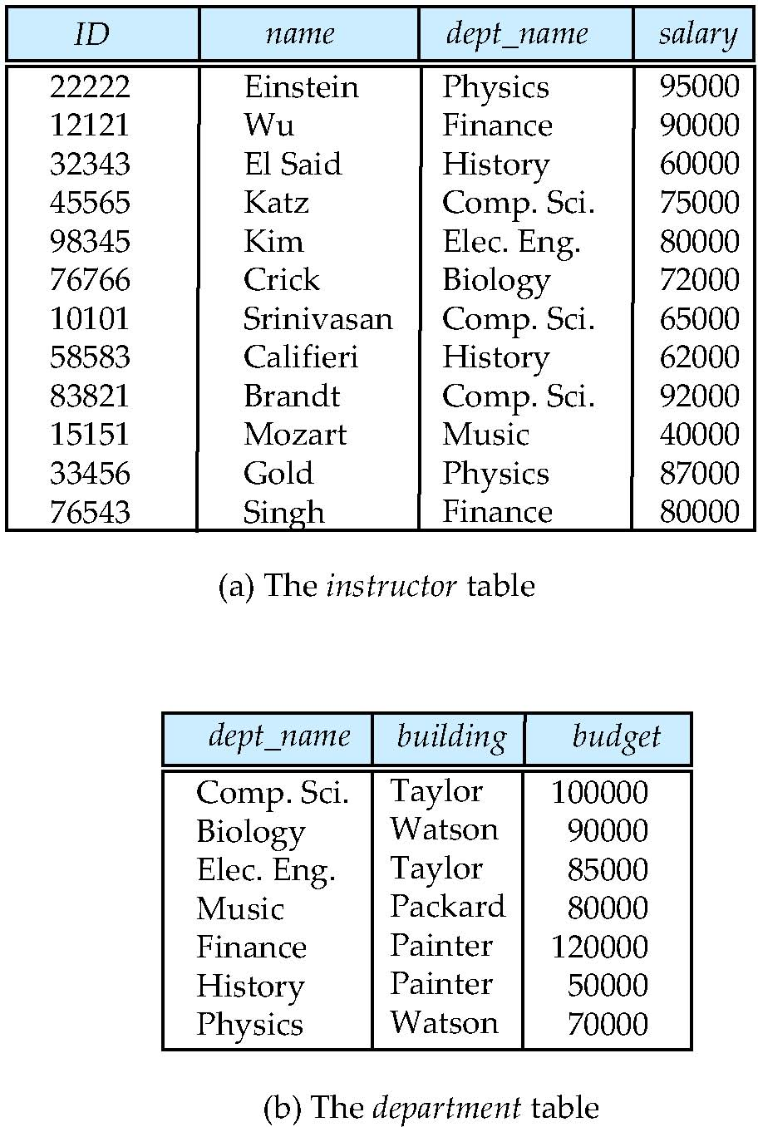
A Sample Relational Database
Notes:
11

Slide 12
Database languages:
Data definition language
Data manipulation language

Slide 13
Data Definition Language (DDL)
Specification notation for defining the database schema
Example: create table instructor ( ID char(5), name varchar(20), dept_name varchar(20), salary numeric(8,2))
DDL compiler generates a set of table templates stored in a data dictionary
Data dictionary contains metadata (i.e., data about data)
Database schema
Integrity constraints
Primary key (ID uniquely identifies instructors)
Referential integrity (references constraint in SQL)
e.g. dept_name value in any instructor tuple must appear in department relation
Authorization
Notes:
13

Slide 14
Data Manipulation Language (DML)
Language for accessing and manipulating the data organized by the appropriate data model
DML also known as query language
Two classes of languages
Procedural – user specifies what data is required and how to get those data
Declarative (nonprocedural) – user specifies what data is required without specifying how to get those data
SQL is the most widely used query language
Notes:
14

Slide 15
Main Characteristics of the Database Approach
Self-describing nature of a database system:
A DBMS catalog stores the description of a particular database (e.g. data structures, types, and constraints)
The description is called meta-data.
This allows the DBMS software to work with different database applications.
Insulation between programs and data:
Called program-data independence.
Allows changing data structures and storage organization without having to change the database access programs.
Eg. Expanding table by adding or deleting new field or vice versa, change constraints,

Slide 16
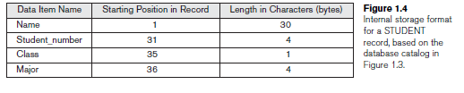
Main Characteristics of the Database Approach (continued)
Data Abstraction:
A data model is used to hide storage details and present the users with a conceptual view of the database.
Programs refer to the data model constructs rather than data storage details
Notes:
eg. Faculty wants to see result of all the students of a particular class. HOD wants to know how many got A+ etc, individual students want only their result that is how much they got in each subject, gpa , grade internal marks etc.
Programmer need nor worry about where , how data is stored and what is its type.

Slide 17
Main Characteristics of the Database Approach (continued)
Support of multiple views of the data:
Each user may see a different view of the database, which describes only the data of interest to that user.
Notes:
eg. Faculty wants to see result of all the students of a particular class. HOD wants to know how many got A+ etc, individual students want only their result that is how much they got in each subject, gpa , grade internal marks etc.

Slide 18
Main Characteristics of the Database Approach (continued)
Sharing of data and multi-user transaction processing:
Allowing a set of concurrent users to retrieve from and to update the database.
Concurrency control within the DBMS guarantees that each transaction is correctly executed or aborted
Recovery subsystem ensures each completed transaction has its effect permanently recorded in the database
OLTP (Online Transaction Processing) is a major part of database applications. This allows hundreds of concurrent transactions to execute per second.
Notes:
A
transaction is an executing program or process that includes one or more database
accesses, such as reading or updating of database records. Each transaction is supposed
to execute a logically correct database access if executed in its entirety without
interference from other transactions

Slide 19
View of the data
DBS is a collection of interrelated data and set of programs that allows users to access and modify these data.
DBS provides abstract view, i.e., hides how data is stored and maintained.

Slide 20
Levels of Abstraction
Physical level: describes how a data (e.g., customer detail) is stored.
Logical level: describes what data are stored in database, and the relationships among the data.
type instructor = record
ID : string; name : string; dept_name : string; salary : integer;
end;
View level: application programs hide details of data types. Views can also hide information (such as an employee’s salary) for security purposes.
Notes:
20
View level is achieved with the help of role based access concept , supported by the DBMS

Slide 21
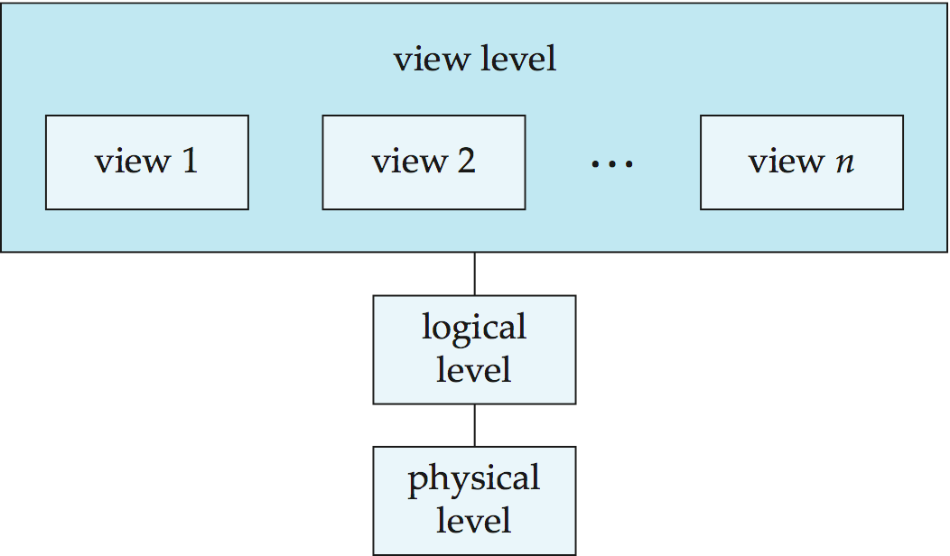
View of Data
An architecture for a database system
Notes:
21

Slide 22
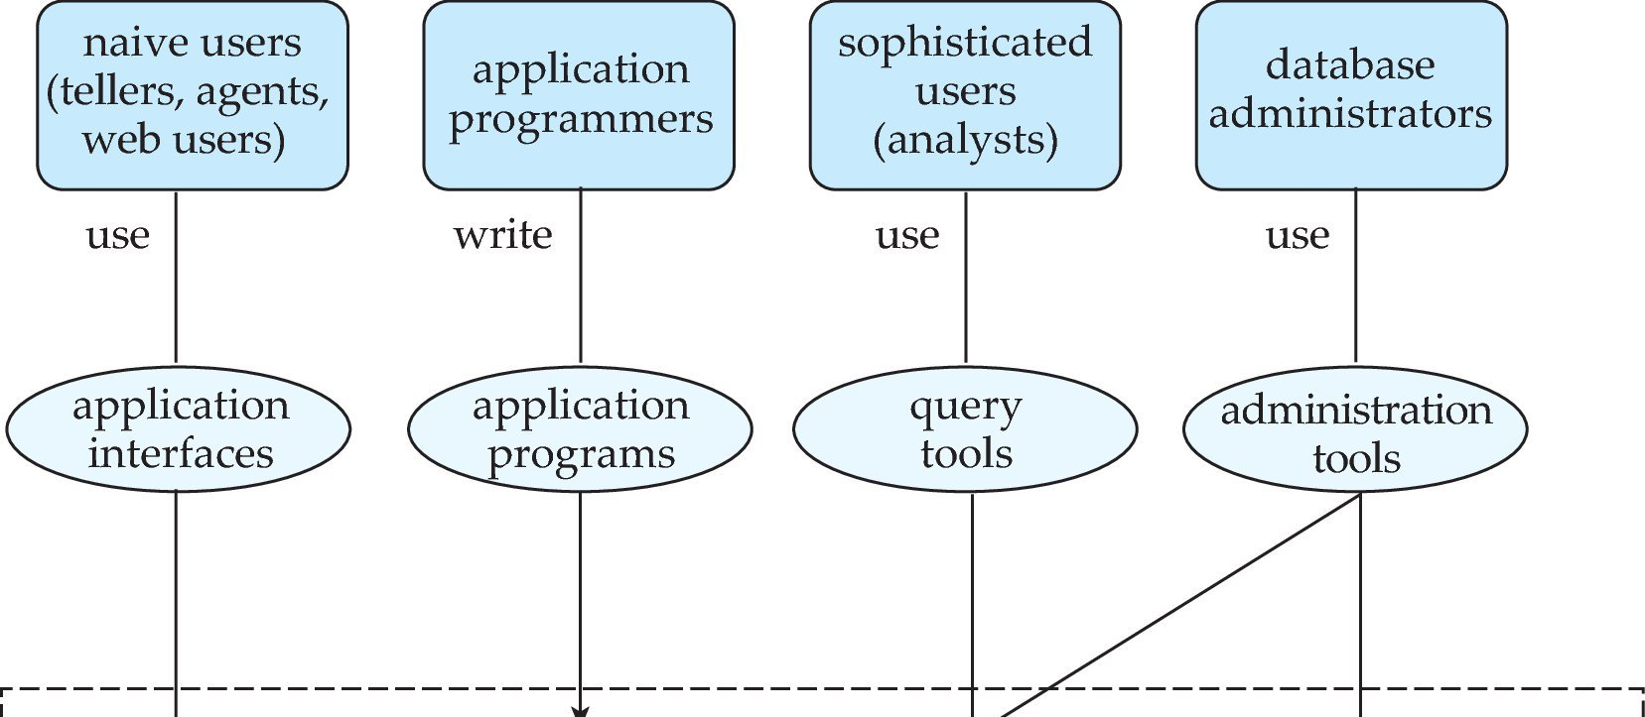
Database Users and Administrators
Database
Notes:
22

Slide 23
Database Users
Users may be divided into
Those who actually use and control the database content, and those who design, develop and maintain database applications (called “Actors on the Scene”), and
Those who design and develop the DBMS software and related tools, and the computer systems operators (called “Workers Behind the Scene”).

Slide 24
Database Users
Actors on the scene
1.Database administrators:
Responsible for authorizing access to the database, for coordinating and monitoring its use, acquiring software and hardware resources, controlling its use and monitoring efficiency of operations.
2.Database Designers:
Responsible to define the content, the structure, the constraints, and functions or transactions against the database. They must communicate with the end-users and understand their needs.

Slide 25
Actors on the scene (continued)
3.End-users: They use the data for queries, reports and some of them update the database content. End-users can be categorized into:
Casual: access database occasionally when needed
Naïve or Parametric: they make up a large section of the end-user population.
They use previously well-defined functions in the form of “canned transactions” against the database.
Examples are bank-tellers or reservation clerks who do this activity for an entire shift of operations.
Notes:
Canned transactions are standard types of queries and updates that have been carefully programmed and tested which is frequently used by Naive or parametric end users to constantly querying and updating database.
a skilled IT person would create a process for the non-IT-skilled worker to do that is very easy to follow and should almost be impossible to make a mistake that would cause harm.

Slide 26
Categories of End-users (continued)
Sophisticated:
These include business analysts, scientists, engineers, others thoroughly familiar with the system capabilities.
Many use tools in the form of software packages that work closely with the stored database.
Stand-alone:
Maintain personal databases using ready-to-use packaged applications.
An example is a tax program user that creates its own internal database.
Another example is a user that maintains an address book
Notes:
Sophisticated Users interact with the system without writing programs :They form requests by writing queries in a database query language

Slide 27
Actors..
4. System analyst and application programmers
system analyst determine the requirements and develop specification for these
Application programmers implement these specifications

Slide 28
Workers behind the Scene
1.DBMS system designers and implementers are persons who design and implement the DBMS modules and interfaces as a software package.
2. Tool developers include persons who design and implement tools—the software packages that facilitate database system design and use, and help improve performance.
3. Operators and maintenance personnel (system administration personnel) are responsible for the actual running and maintenance of the hardware and software environment for the database system.

Slide 29
Advantages of Using the Database Approach
Controlling redundancy
Traditional file system has following issues;
Multiple updates
Storage wastage
Inconsistency
Solution: data normalization and controlled redundancy
Restricting unauthorized access to data- security and authorization subsystem is provided
Providing persistent storage for program objects: object oriented DB
Notes:
Providing Storage Structures :

Slide 30
4. Providing Storage Structures (e.g. indexes) for efficient Query Processing
Indexes could be provided
Buffering or caching modules are available
Query processing and optimizing module

Slide 31
Advantages of Using the Database Approach (continued)
Providing backup and recovery services.
- on failure, DB has to be restored to state of consistency or resumed
Providing multiple interfaces to different classes of users.
- forms, command, codes, menu driven , natural language interface
Representing complex relationships among data.
-should have capability to represent variety of relationships
Notes:
Employees salary must be less than his/her supervisors salary.
Drawing inferences and actions from the stored data using deductive and active rules

Slide 32
8. Enforcing integrity constraints on the database.
Datatype should be provided
Referential integrity
Uniqueness of data
9. Permitting inferences and action using rules
-infer new information through rules(codes)
Triggers
Stored procedures

Slide 33
10. other benefits:
Enforcing standards
Reducing application development time
Flexibility
Up to date information
Economies of scale

Slide 34
Database Architecture
The architecture of a database systems is greatly influenced by the underlying computer system on which the database is running:
Centralized
Client-server
Parallel (multi-processor)
Distributed
Notes:
34

Slide 35
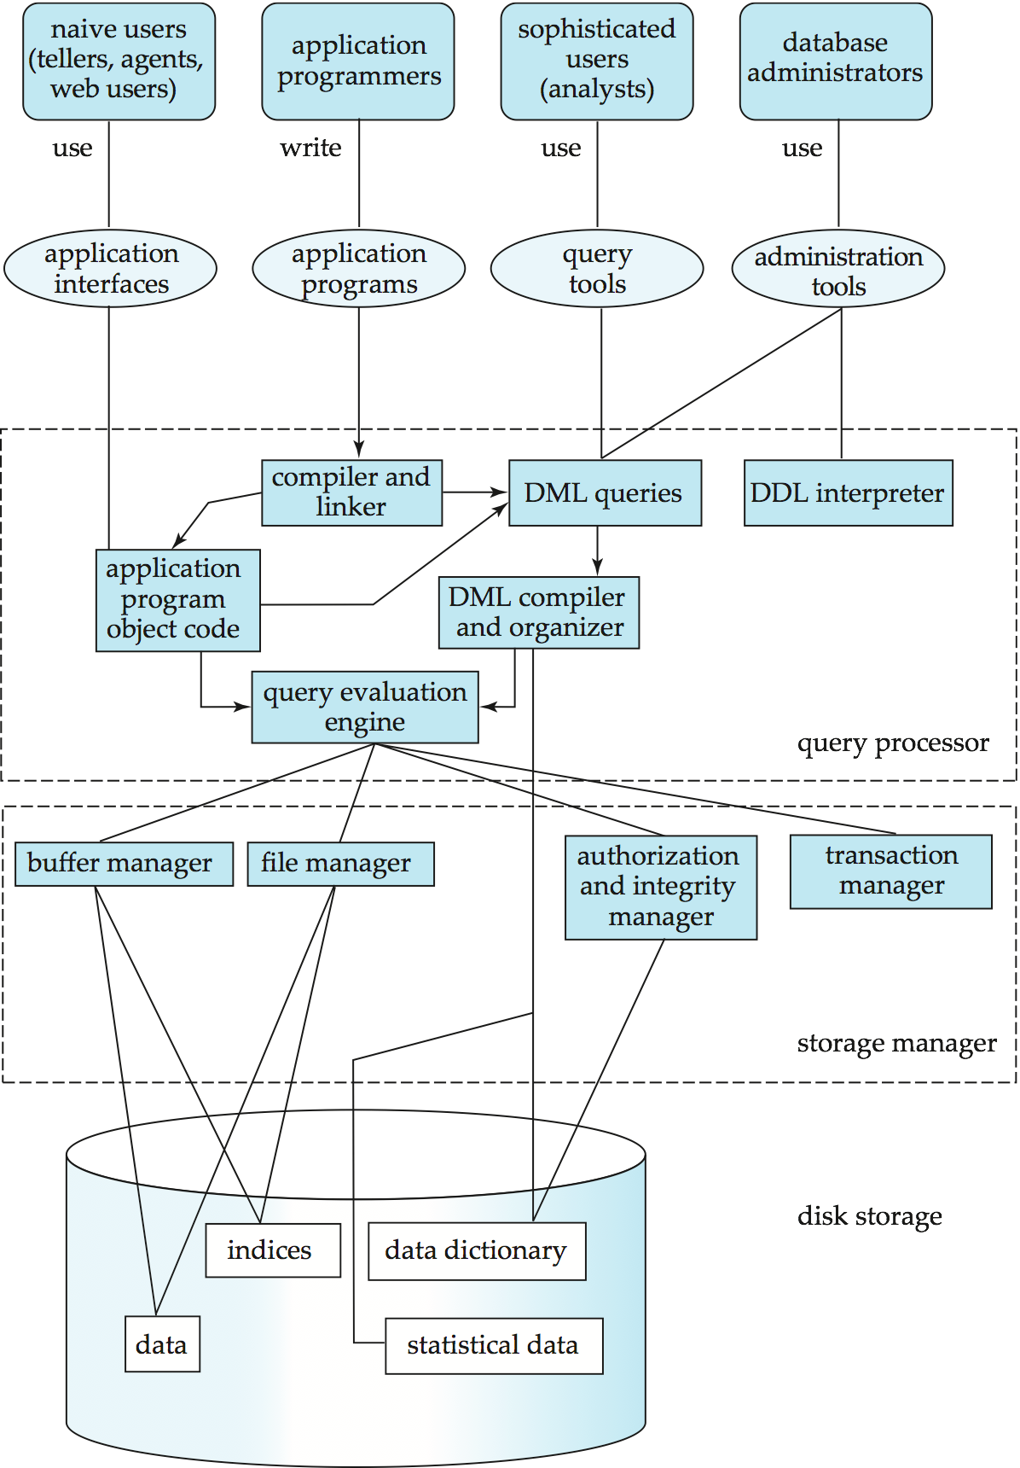
Database System Internals
At remote site
Notes:
35

Slide 36
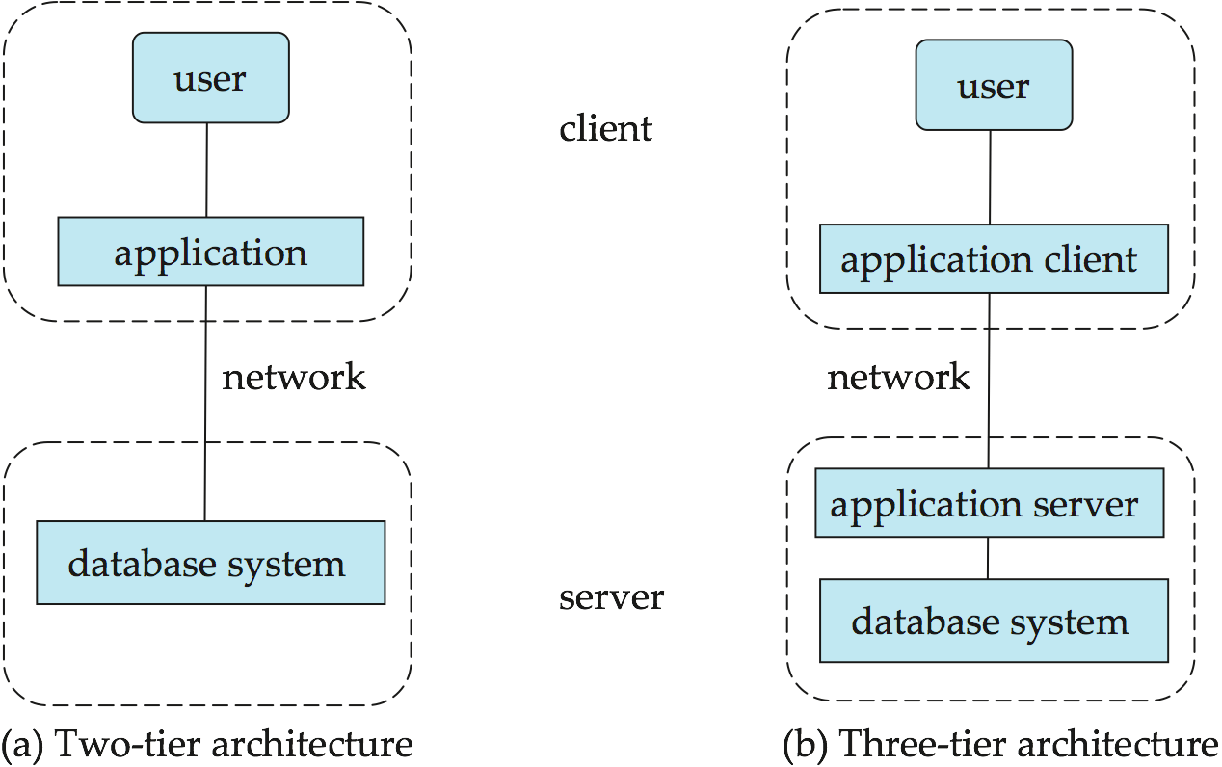
Figure 1.06
Notes:
36

Slide 37
Database applications are partitioned into 2 or 3 parts
In a two tier architecture, the application resides at the client machine where it invokes database system functionality at the server machine through queries.
API standards such as ODBC, JDBC are used for interaction between the client and the server.

Slide 38
In a 3 tier architecture, the client machine acts as a front end.
The client machine communicates with the application server, usually through forms
The application server in turn communicates with a database system to access data
All logic is embedded in the application server.

